Slide 1




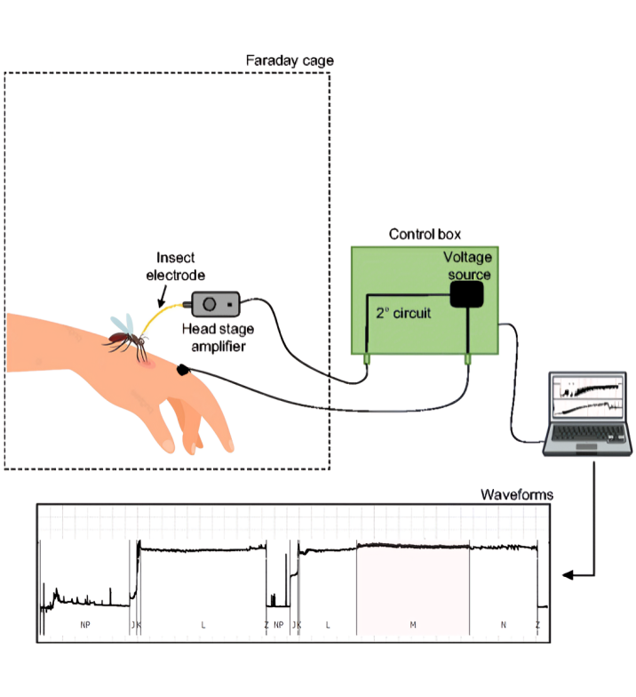
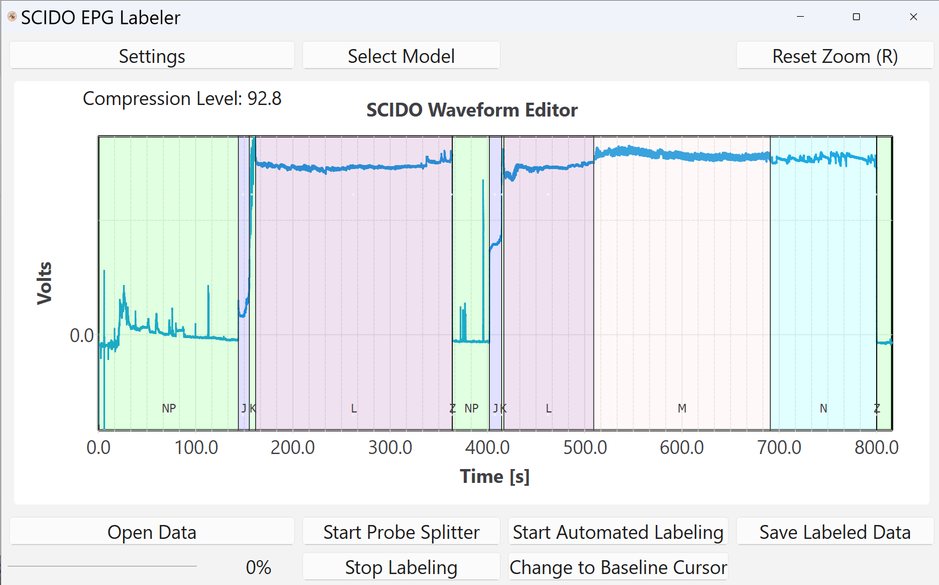
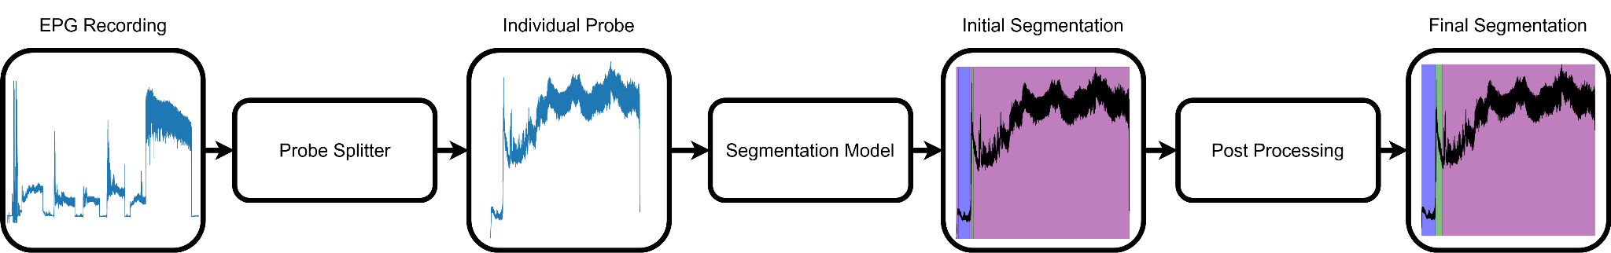
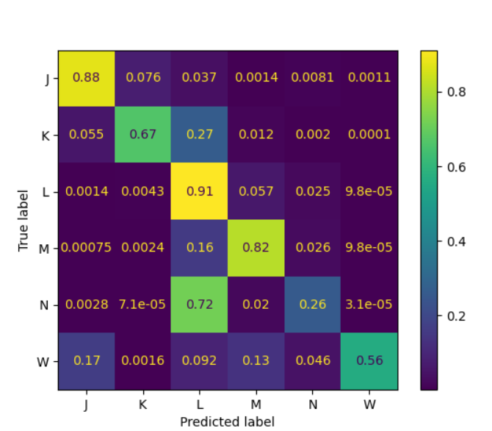
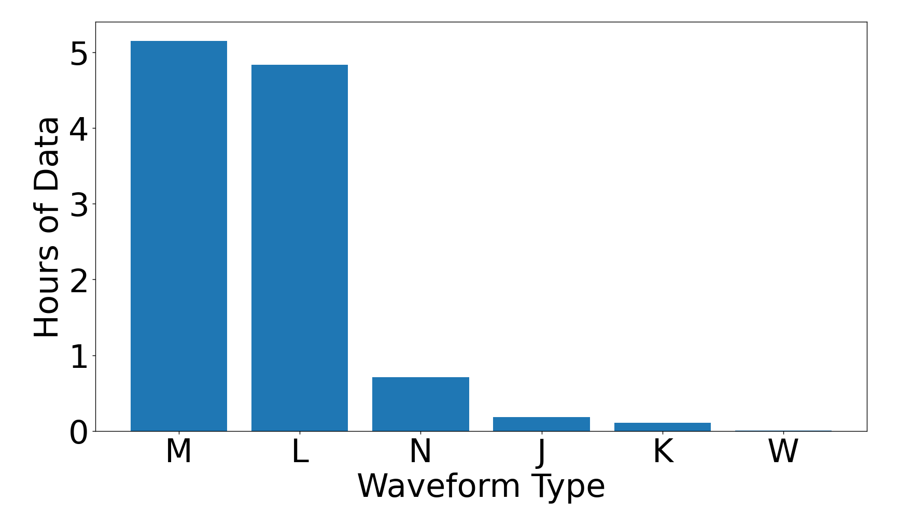



Auburn-USDA
ML for Mosquito Feeding Classification
Background and Motivation
Agricultural production is under constant threat from pests like mosquitoes.
Understanding mosquito feeding is crucial for protecting livestock yields.
A powerful technique for studying insect feeding is electropenetography (EPG).
Labeling EPG waveforms is slow, so we implemented machine learning models to automate the process and an interface to use them.
How EPG Works
SCIDO EPG Labeler
Pipeline
Machine Learning
UNet Confusion Matrix
Model Results
Data Distribution
Model | Accuracy (%) | F1
UNet | 84 | 0.66
Random Forests | 77 | 0.39
Fully Convolutional Network | 79 | 0.37
Segmentation Transformer | 74 | 0.39
Next Steps
Expand these models to other insect species
Add the ability to train models within SCIDO
Work will be continued by two HMC interns over the summer
Team Members: Mehrezat Abbas (Fall TL), Devanshi Guglani, Milo Knell, Zachary Traul (Spring TL), Lillian Vernooy
Advisor: Prof. Gabriel Hope
Liaisons: Dr. Cooper (Auburn), Dr. Reif (Auburn), Dr. Backus (USDA)
Funding: USDA (58-2034-3-445), USDA (58-3022-4-034), NSF (DBI - 2304787)
Citations
Cooper, Anastasia M. W., Samuel B. Jameson, Victoria Pickens, Cameron
Osborne, Elaine A. Backus, Kristopher Silver, and Dana N. Mitzel. 2024. An electropenetrography waveform library for the probing and ingestion behaviors of culex tarsalis on human hands. Insect Science 31(4):1165–1186. doi:10.1111/1744-7917.1329
Notes:
Background and Motivation
Understanding the feeding behaviors of invasive pests like aphids, sharpshooters, and mosquitoes, our sponsors’ focus, is difficult because their mouths are hidden inside their host while they feed. Electropenetrography (EPG) is a technique for overcoming this difficulty that works by wiring the insect and its host in series and measuring the voltage drop across the insect and host. As the insect feeds on its host, the voltage drop will vary depending on their behavior, whether that’s probing, salivating, or ingesting. Plotting this voltage against time, scientists obtain a plot like the one in our software below. However, segmenting these waveforms into relevant behaviors is time consuming for our sponsors. Therefore, they seek a solution to speed up this process.
Describe EPG (wired bug)
Labeling time consuming
Need labels for large-scale studies
Objective
Create a software tool that uses machine learning to automate EPG segmentation, accelerating EPG research.
Software
SCIDO: Supervised Classification of Insect Data and Outcomes
Image caption explaining waveform and software state in image
ML (Flowchart + Results Table)
Dataset
Flowchart from raw data → probes → model → postprocessing → labeled data
Results Table
Next Steps
To be handed off to summer interns for:
Apply to other species
Add training functionality to software
People’s Names
NSF ack.
Citations

